Slide 1

Codergirl – Frontend
Unit 2 - Class 16
Feb 1, 2021
Notes:
1

Slide 2
Agenda
Section 20: Authentication & Route Protection in Angular
Section 21: Dynamic Components
Notes:
2

Slide 3
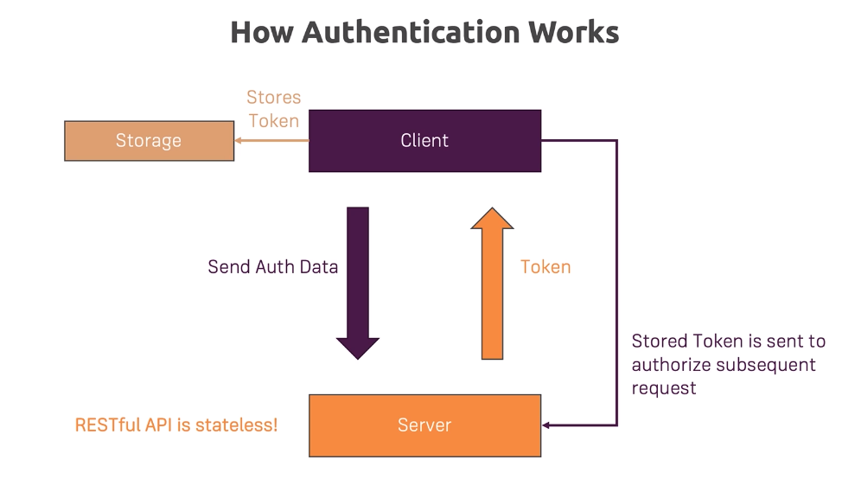
Notes:
Server sends a token first and only server can authenticate it.
3

Slide 4
RECIPE LIST
New area in the application called Auth - AuthComponent.
Notes:
4

Slide 5
APP MODULE
Notes:
5

Slide 6
HEADER COMPONENT
Notes:
6

Slide 7
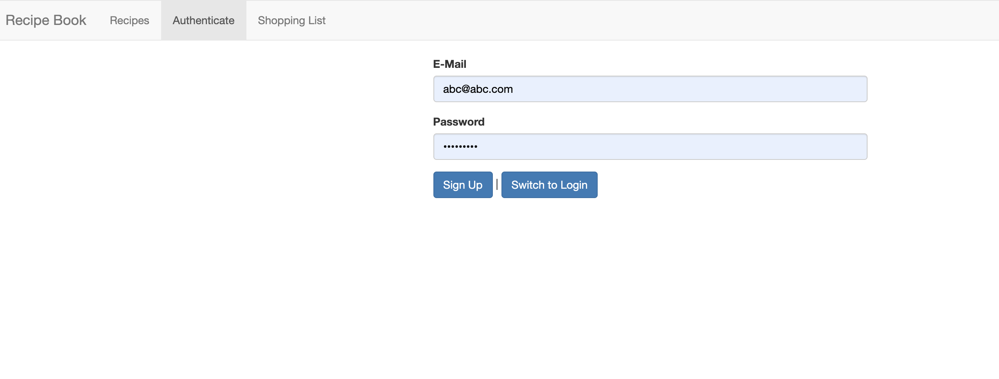
AUTH COMPONENT
Notes:
7

Slide 8
SWITCHING BETWEEN AUTH MODES
Notes:
8

Slide 9
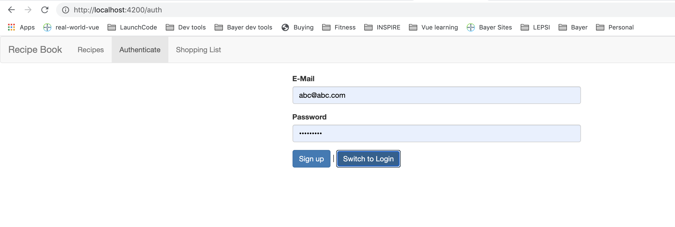
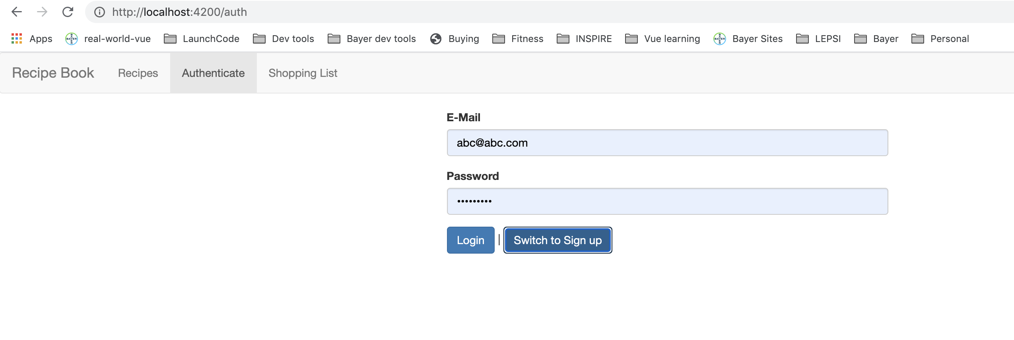
SWITCHING BETWEEN AUTH MODES
Notes:
9

Slide 10
HANDLING FORM INPUT
Notes:
10

Slide 11
HANDLING FORM INPUT
Notes:
11

Slide 12
HANDLING FORM INPUT
Notes:
12

Slide 13
PREPARING THE BACKEND
{
"rules": {
".read": "now < 1614578400000", // 2021-3-1
".write": "now < 1614578400000", // 2021-3-1
}
}
Notes:
13

Slide 14
PREPARING THE BACKEND
{
"rules": {
".read": auth != null,// 2021-3-1
".write": auth != null, // 2021-3-1
}
}
Notes:
14

Slide 15
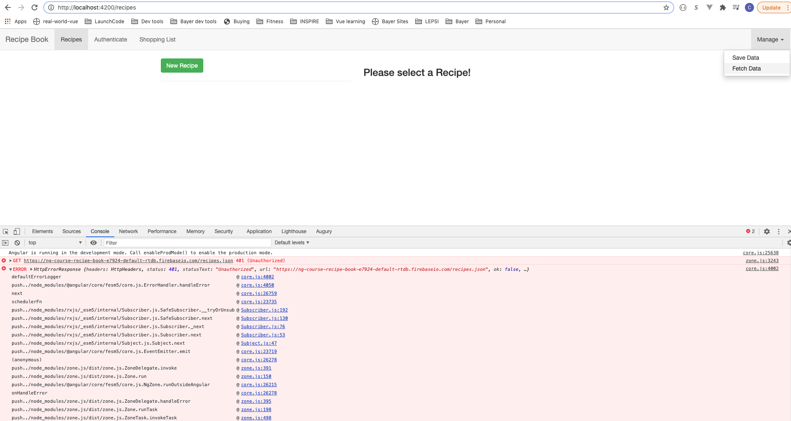
PREPARING THE BACKEND
Notes:
15

Slide 16
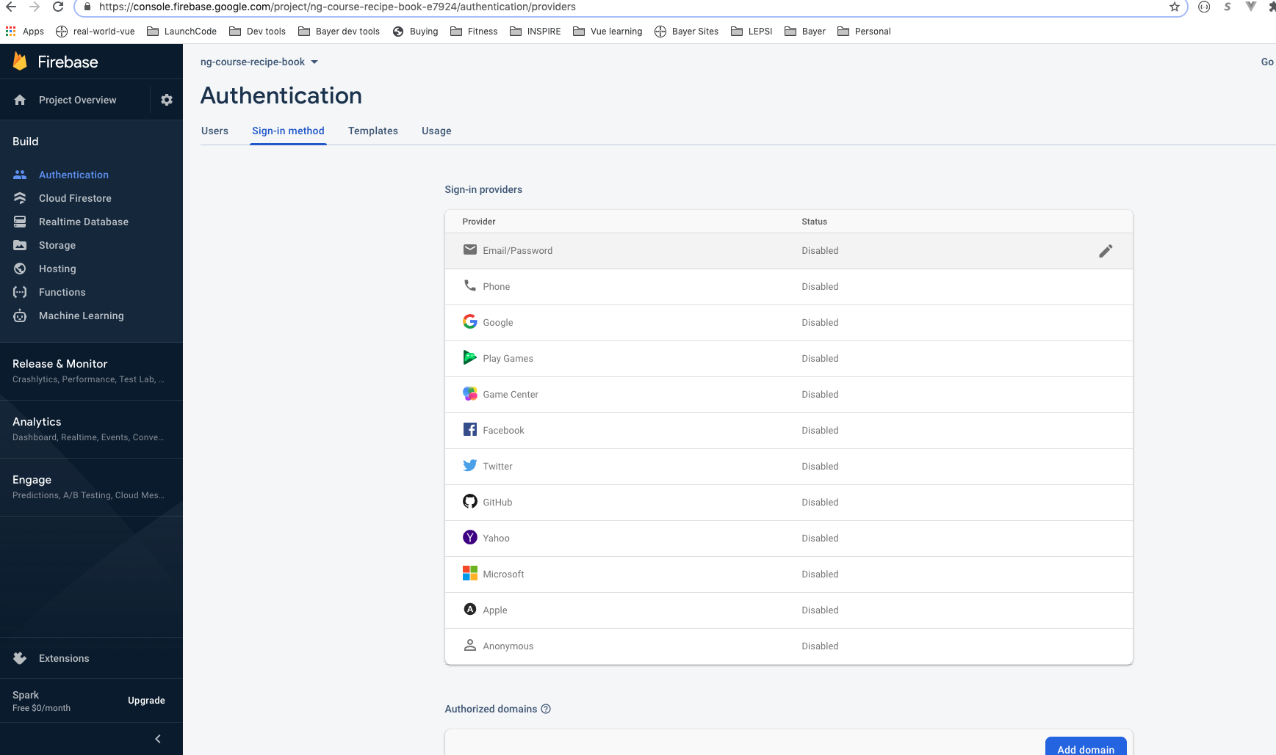
PREPARING THE BACKEND
Notes:
16

Slide 17
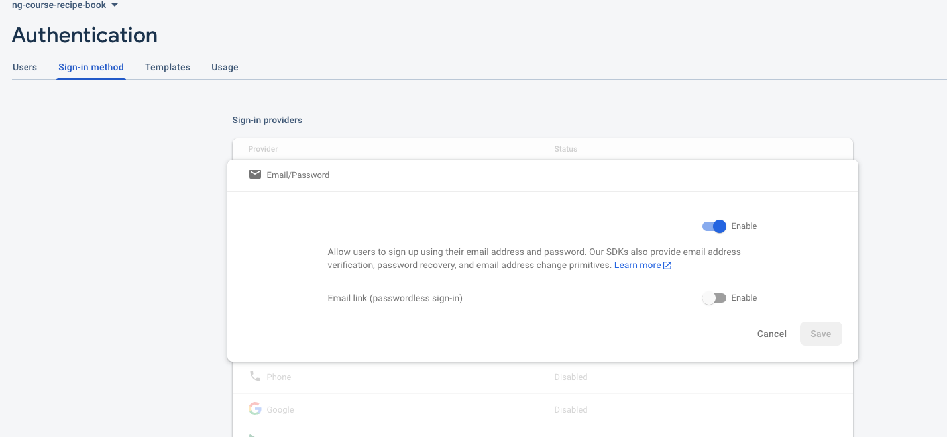
PREPARING THE BACKEND
Notes:
17

Slide 18
PREPARING THE BACKEND
Notes:
18

Slide 19
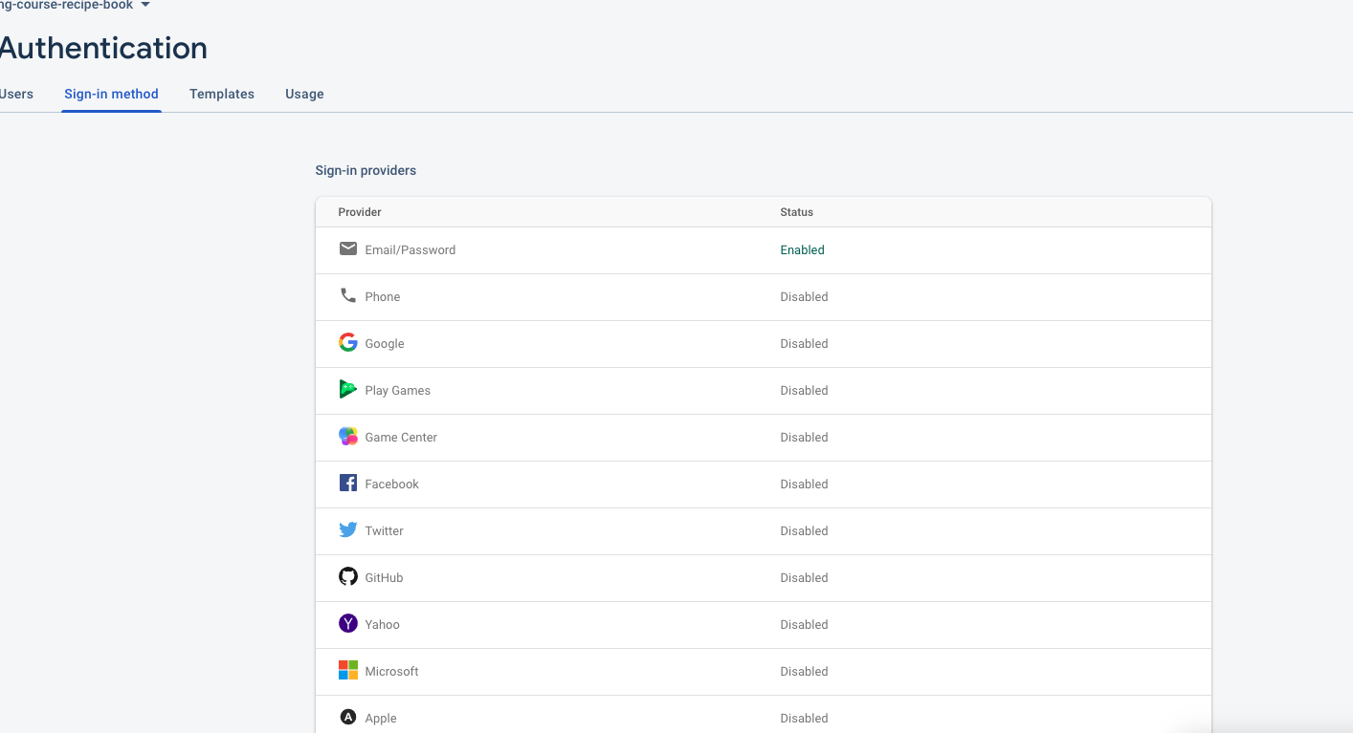
PREPARING THE BACKEND
Notes:
19

Slide 20
PREPARING THE SINGUP REQUEST
Notes:
https://cloud.google.com/identity-platform/docs/reference/rest/v1/accounts/signUp
https://cloud.google.com/identity-platform/docs/reference/rest/v1/accounts/signUp?apix_params=%7B%22resource%22%3A%7B%22email%22%3A%22chetna.aggarwal%40gmail.com%22%2C%22password%22%3A%22test%22%7D%7D
20

Slide 21
PREPARING THE SINGUP REQUEST
Notes:
https://cloud.google.com/identity-platform/docs/reference/rest/v1/accounts/signUp
https://cloud.google.com/identity-platform/docs/reference/rest/v1/accounts/signUp?apix_params=%7B%22resource%22%3A%7B%22email%22%3A%22chetna.aggarwal%40gmail.com%22%2C%22password%22%3A%22test%22%7D%7D
21

Slide 22
PREPARING THE SINGUP REQUEST
Notes:
https://cloud.google.com/identity-platform/docs/reference/rest/v1/accounts/signUp
https://cloud.google.com/identity-platform/docs/reference/rest/v1/accounts/signUp?apix_params=%7B%22resource%22%3A%7B%22email%22%3A%22chetna.aggarwal%40gmail.com%22%2C%22password%22%3A%22test%22%7D%7D
22

Slide 23
PREPARING THE SINGUP REQUEST
Notes:
https://cloud.google.com/identity-platform/docs/reference/rest/v1/accounts/signUp
https://cloud.google.com/identity-platform/docs/reference/rest/v1/accounts/signUp?apix_params=%7B%22resource%22%3A%7B%22email%22%3A%22chetna.aggarwal%40gmail.com%22%2C%22password%22%3A%22test%22%7D%7D
23

Slide 24
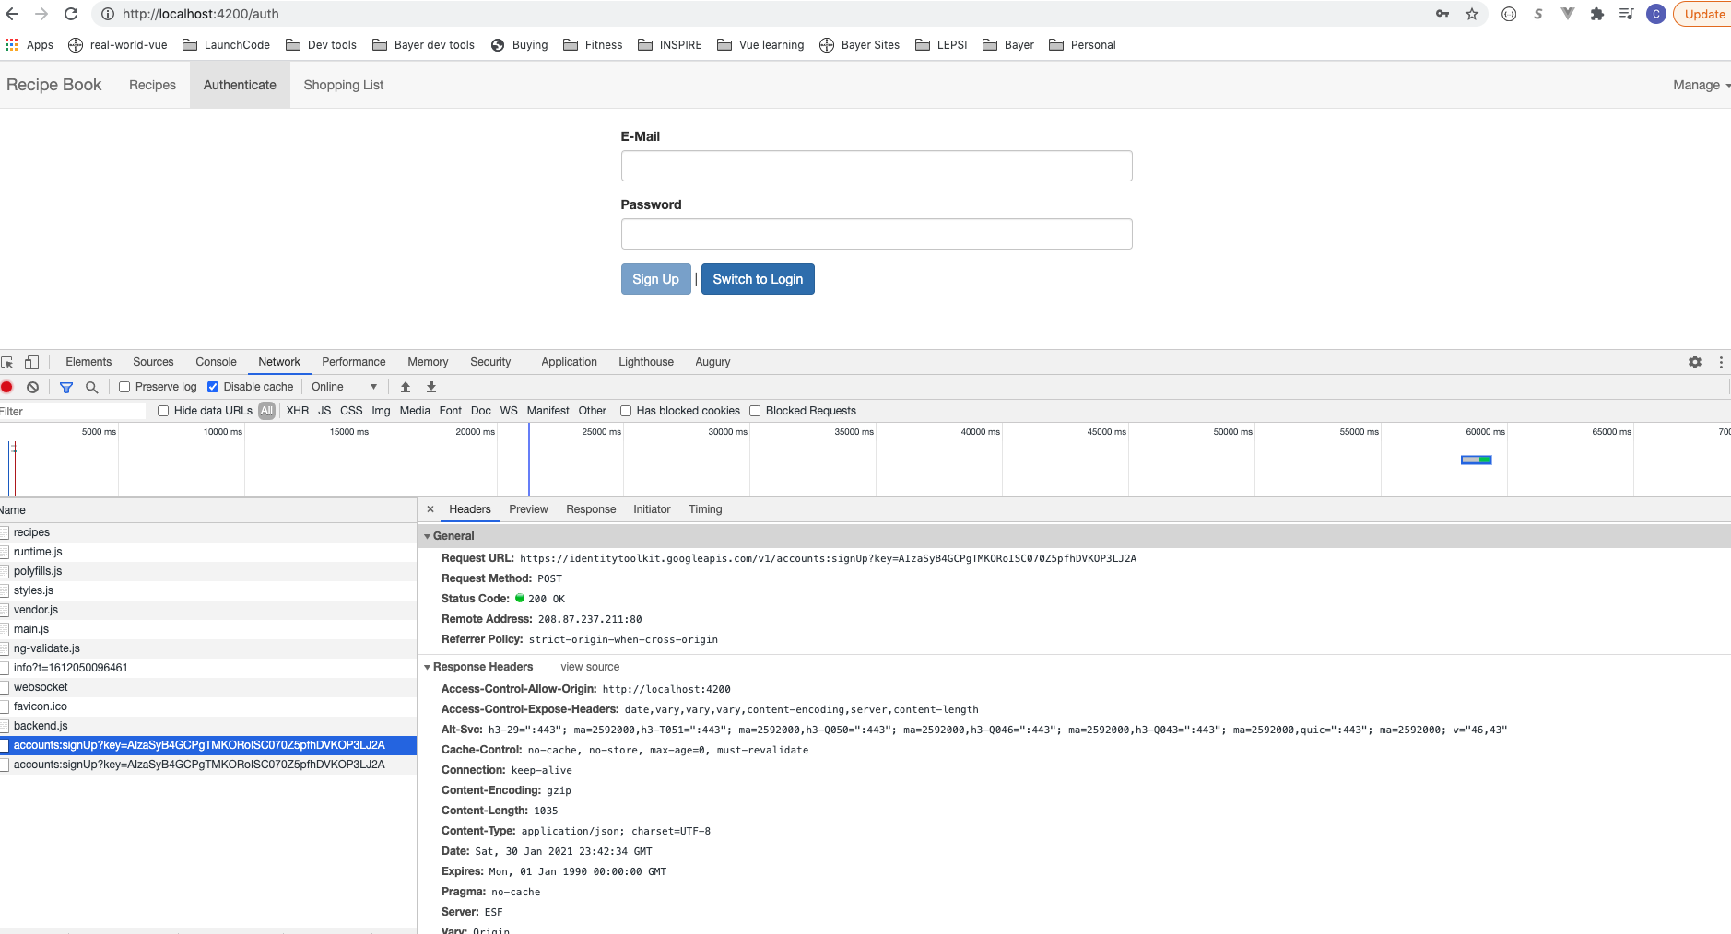
PREPARING THE SINGUP REQUEST
Notes:
https://cloud.google.com/identity-platform/docs/reference/rest/v1/accounts/signUp
https://cloud.google.com/identity-platform/docs/reference/rest/v1/accounts/signUp?apix_params=%7B%22resource%22%3A%7B%22email%22%3A%22chetna.aggarwal%40gmail.com%22%2C%22password%22%3A%22test%22%7D%7D
24

Slide 25
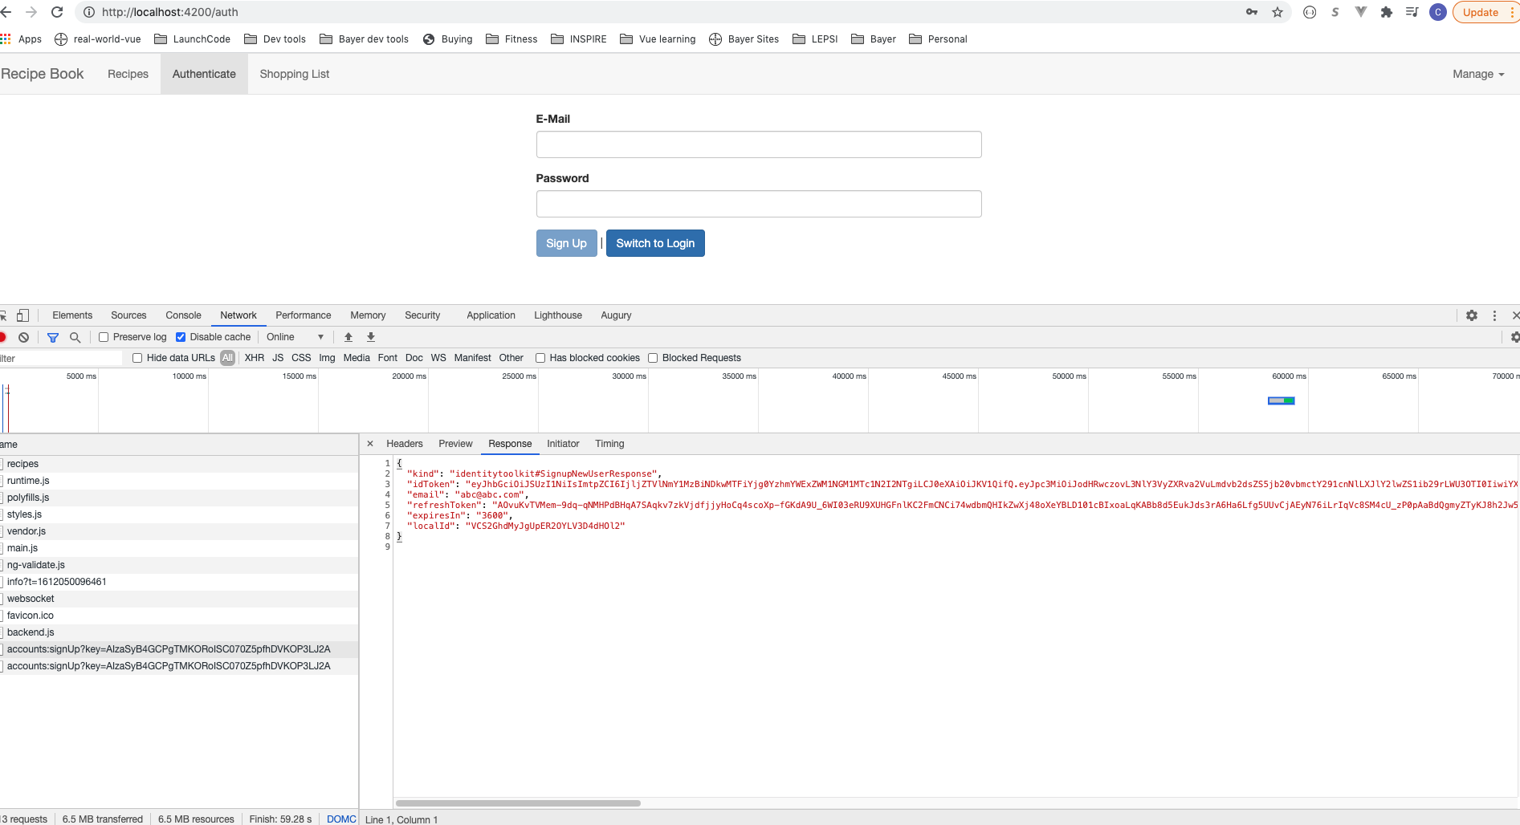
PREPARING THE SINGUP REQUEST
Notes:
https://cloud.google.com/identity-platform/docs/reference/rest/v1/accounts/signUp
https://cloud.google.com/identity-platform/docs/reference/rest/v1/accounts/signUp?apix_params=%7B%22resource%22%3A%7B%22email%22%3A%22chetna.aggarwal%40gmail.com%22%2C%22password%22%3A%22test%22%7D%7D
25

Slide 26
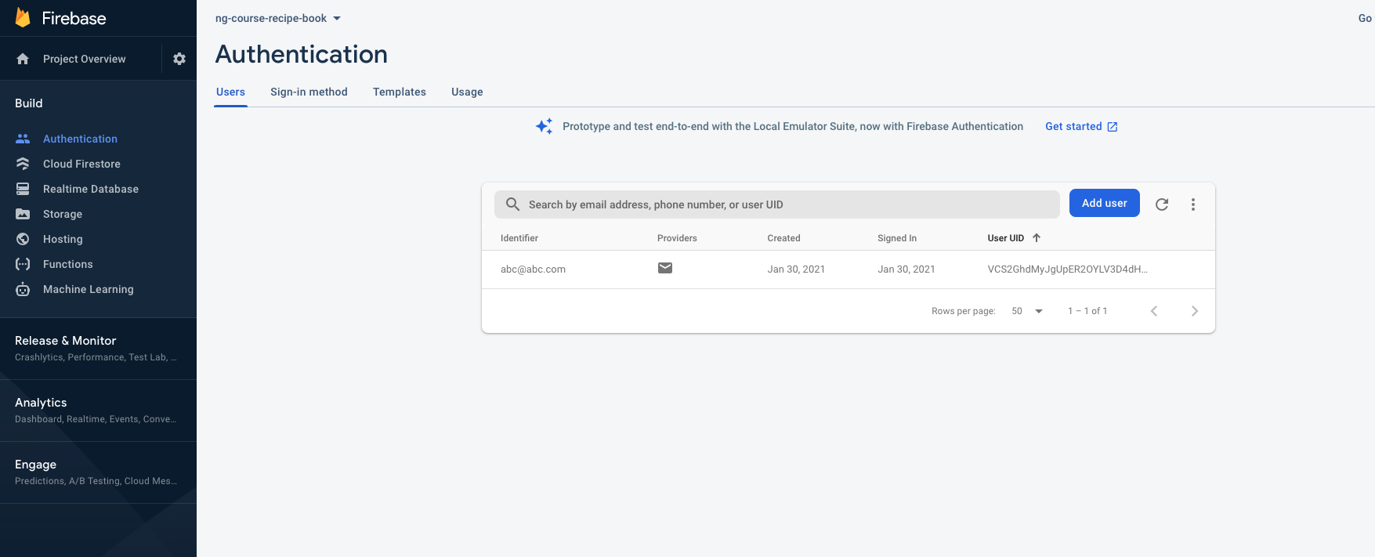
PREPARING THE SINGUP REQUEST
Notes:
https://cloud.google.com/identity-platform/docs/reference/rest/v1/accounts/signUp
https://cloud.google.com/identity-platform/docs/reference/rest/v1/accounts/signUp?apix_params=%7B%22resource%22%3A%7B%22email%22%3A%22chetna.aggarwal%40gmail.com%22%2C%22password%22%3A%22test%22%7D%7D
26

Slide 27
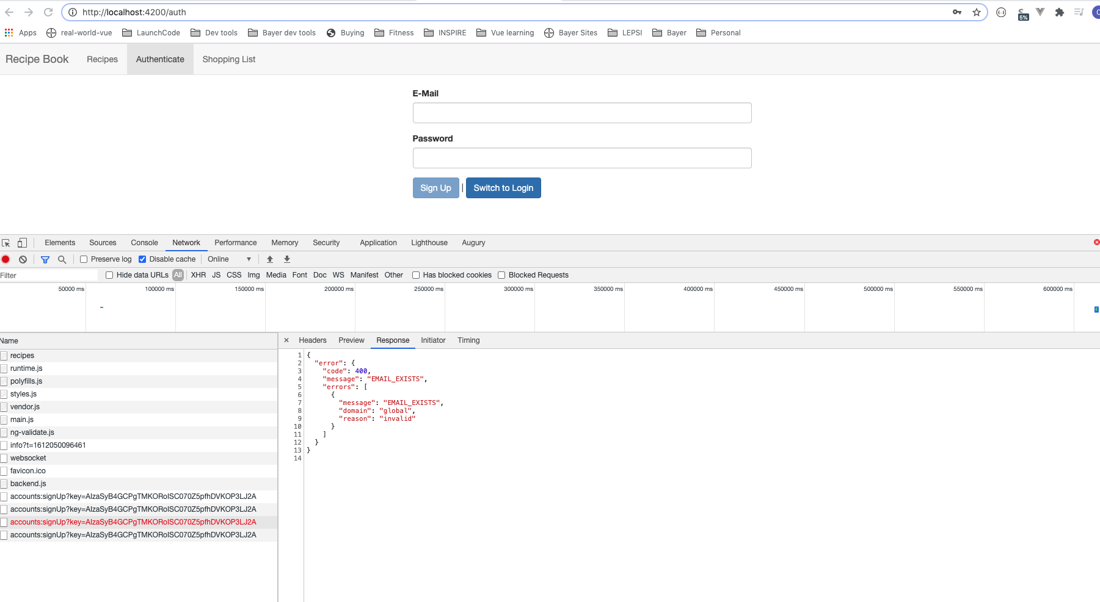
PREPARING THE SINGUP REQUEST
Notes:
https://cloud.google.com/identity-platform/docs/reference/rest/v1/accounts/signUp
https://cloud.google.com/identity-platform/docs/reference/rest/v1/accounts/signUp?apix_params=%7B%22resource%22%3A%7B%22email%22%3A%22chetna.aggarwal%40gmail.com%22%2C%22password%22%3A%22test%22%7D%7D
27

Slide 28
ADDING A LOADING SPINNER AND ERROR HANDLING
Notes:
https://cloud.google.com/identity-platform/docs/reference/rest/v1/accounts/signUp
https://cloud.google.com/identity-platform/docs/reference/rest/v1/accounts/signUp?apix_params=%7B%22resource%22%3A%7B%22email%22%3A%22chetna.aggarwal%40gmail.com%22%2C%22password%22%3A%22test%22%7D%7D
28

Slide 29
ADDING A LOADING SPINNER AND ERROR HANDLING
Notes:
https://loading.io/css
29

Slide 30
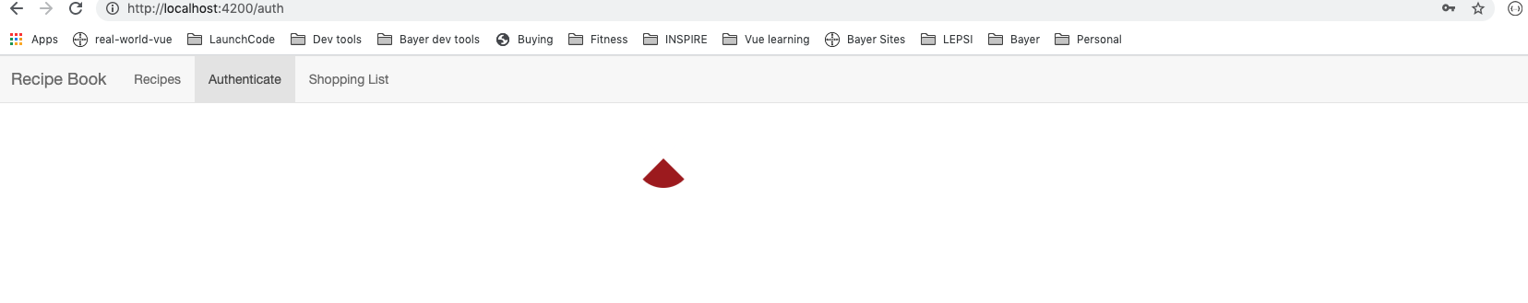
ADDING A LOADING SPINNER AND ERROR HANDLING
Notes:
https://cloud.google.com/identity-platform/docs/reference/rest/v1/accounts/signUp
https://cloud.google.com/identity-platform/docs/reference/rest/v1/accounts/signUp?apix_params=%7B%22resource%22%3A%7B%22email%22%3A%22chetna.aggarwal%40gmail.com%22%2C%22password%22%3A%22test%22%7D%7D
30

Slide 31
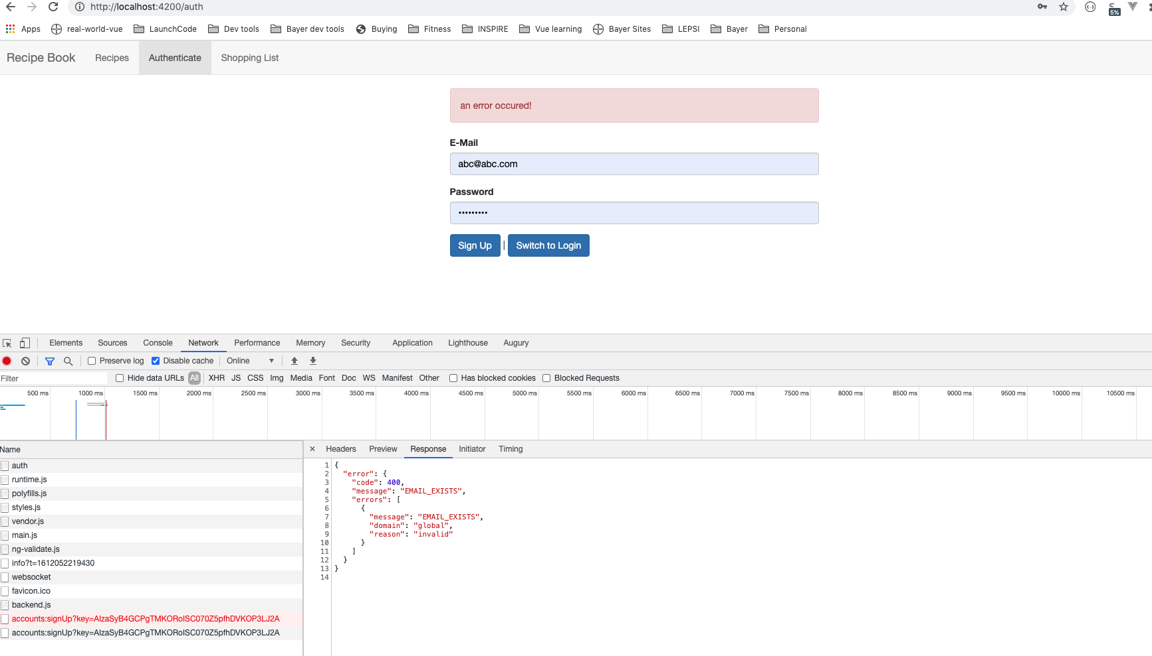
ADDING A LOADING SPINNER AND ERROR HANDLING
Notes:
https://cloud.google.com/identity-platform/docs/reference/rest/v1/accounts/signUp
https://cloud.google.com/identity-platform/docs/reference/rest/v1/accounts/signUp?apix_params=%7B%22resource%22%3A%7B%22email%22%3A%22chetna.aggarwal%40gmail.com%22%2C%22password%22%3A%22test%22%7D%7D
31

Slide 32
ADDING A LOADING SPINNER AND ERROR HANDLING
Notes:
https://cloud.google.com/identity-platform/docs/reference/rest/v1/accounts/signUp
https://cloud.google.com/identity-platform/docs/reference/rest/v1/accounts/signUp?apix_params=%7B%22resource%22%3A%7B%22email%22%3A%22chetna.aggarwal%40gmail.com%22%2C%22password%22%3A%22test%22%7D%7D
32

Slide 33
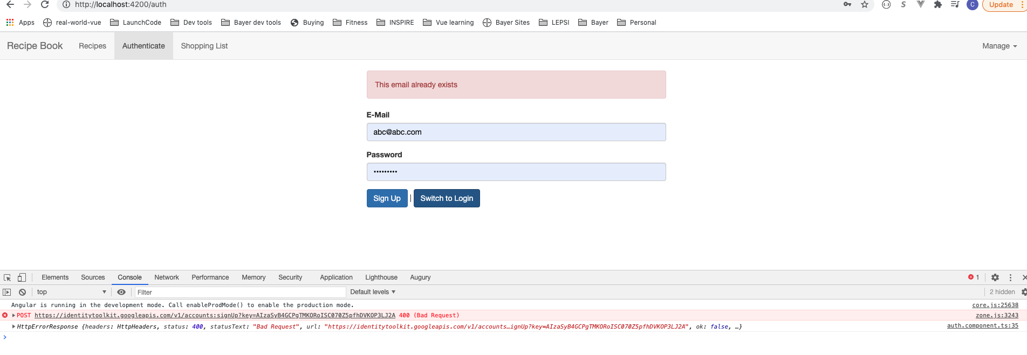
ADDING A LOADING SPINNER AND ERROR HANDLING
Notes:
https://cloud.google.com/identity-platform/docs/reference/rest/v1/accounts/signUp
https://cloud.google.com/identity-platform/docs/reference/rest/v1/accounts/signUp?apix_params=%7B%22resource%22%3A%7B%22email%22%3A%22chetna.aggarwal%40gmail.com%22%2C%22password%22%3A%22test%22%7D%7D
33

Slide 34
ADDING A LOADING SPINNER AND ERROR HANDLING
Notes:
https://cloud.google.com/identity-platform/docs/reference/rest/v1/accounts/signUp
https://cloud.google.com/identity-platform/docs/reference/rest/v1/accounts/signUp?apix_params=%7B%22resource%22%3A%7B%22email%22%3A%22chetna.aggarwal%40gmail.com%22%2C%22password%22%3A%22test%22%7D%7D
34

Slide 35
ADDING A LOADING SPINNER AND ERROR HANDLING
Notes:
https://cloud.google.com/identity-platform/docs/reference/rest/v1/accounts/signUp
https://cloud.google.com/identity-platform/docs/reference/rest/v1/accounts/signUp?apix_params=%7B%22resource%22%3A%7B%22email%22%3A%22chetna.aggarwal%40gmail.com%22%2C%22password%22%3A%22test%22%7D%7D
35

Slide 36
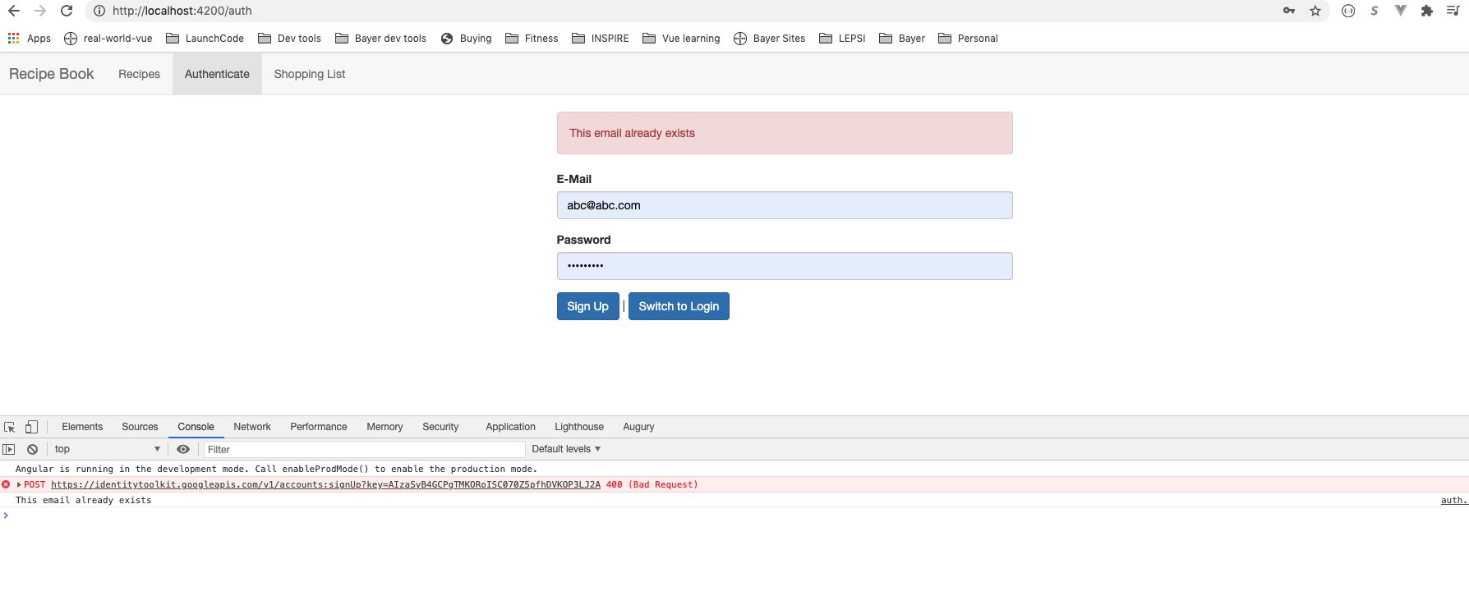
ADDING A LOADING SPINNER AND ERROR HANDLING
Notes:
https://cloud.google.com/identity-platform/docs/reference/rest/v1/accounts/signUp
https://cloud.google.com/identity-platform/docs/reference/rest/v1/accounts/signUp?apix_params=%7B%22resource%22%3A%7B%22email%22%3A%22chetna.aggarwal%40gmail.com%22%2C%22password%22%3A%22test%22%7D%7D
36

Slide 37
SENDING LOGIN REQUESTS
Notes:
https://cloud.google.com/identity-platform/docs/reference/rest/v1/accounts/signInWithPassword
37

Slide 38
SENDING LOGIN REQUESTS
Notes:
https://cloud.google.com/identity-platform/docs/reference/rest/v1/accounts/signInWithPassword
38

Slide 39
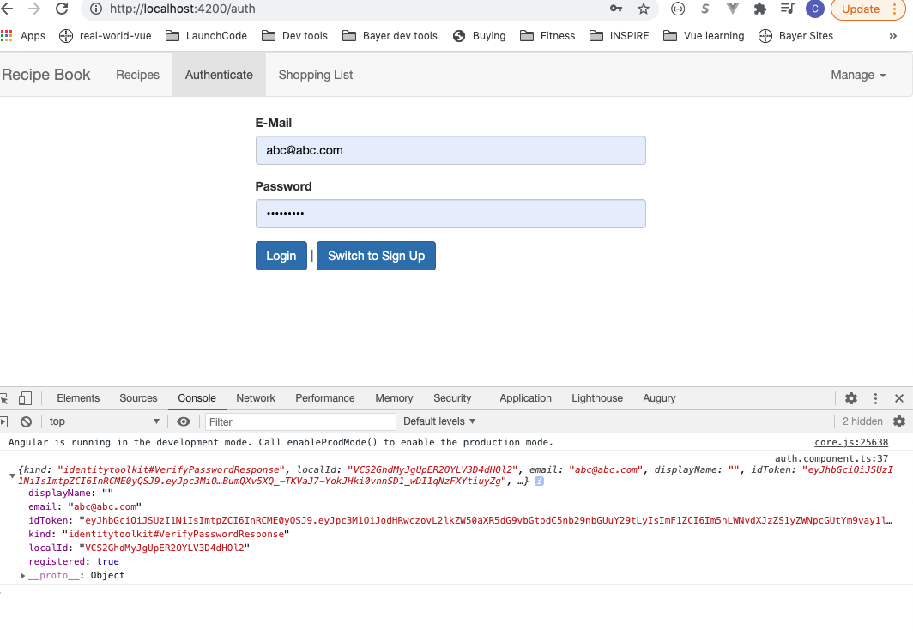
SENDING LOGIN REQUESTS
Notes:
https://cloud.google.com/identity-platform/docs/reference/rest/v1/accounts/signInWithPassword
39

Slide 40
SENDING LOGIN REQUESTS
Notes:
https://cloud.google.com/identity-platform/docs/reference/rest/v1/accounts/signInWithPassword
40

Slide 41
SENDING LOGIN REQUESTS
Notes:
https://cloud.google.com/identity-platform/docs/reference/rest/v1/accounts/signInWithPassword
41

Slide 42
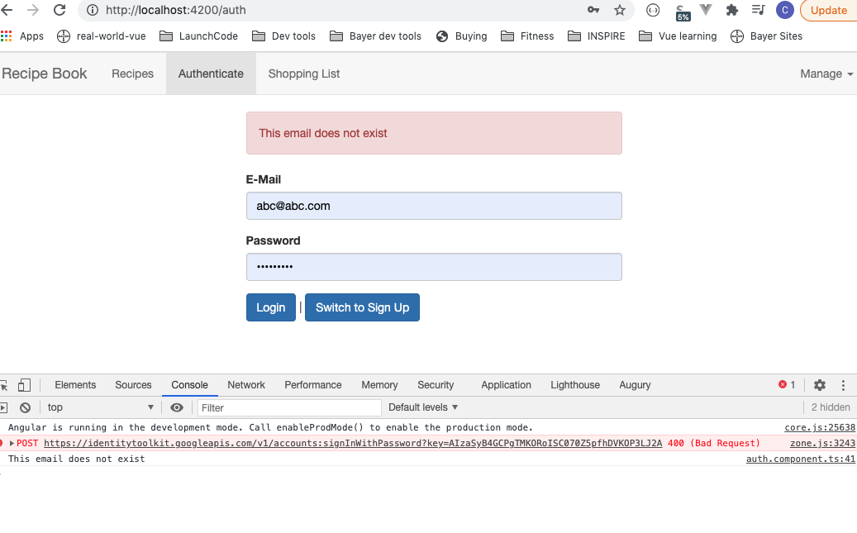
SENDING LOGIN REQUESTS
Notes:
https://cloud.google.com/identity-platform/docs/reference/rest/v1/accounts/signInWithPassword
42

Slide 43
CREATING AND STORING THE USER DATA
Notes:
https://cloud.google.com/identity-platform/docs/reference/rest/v1/accounts/signInWithPassword
Forward to diff route after login/signup in Component
43

Slide 44
REFLECTING THE AUTH STATE IN THE UI
Notes:
https://cloud.google.com/identity-platform/docs/reference/rest/v1/accounts/signInWithPassword
Forward to diff route after login/signup in Component
44

Slide 45
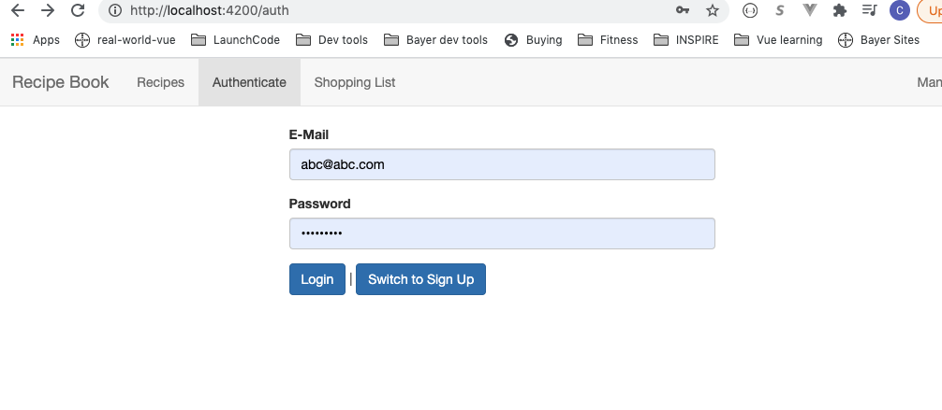
REFLECTING THE AUTH STATE IN THE UI
Notes:
https://cloud.google.com/identity-platform/docs/reference/rest/v1/accounts/signInWithPassword
Forward to diff route after login/signup in Component
45

Slide 46
REFLECTING THE AUTH STATE IN THE UI
Notes:
We want to show relavant message based on user authentication state, and add logout once they are logged in. we want to check if we have a user with an auth token or not. Token expired then user subject will emit and event that updates the user.
46

Slide 47
REFLECTING THE AUTH STATE IN THE UI
Notes:
We want to show relavant message based on user authentication state, and add logout once they are logged in. we want to check if we have a user with an auth token or not. Token expired then user subject will emit and event that updates the user.
47

Slide 48
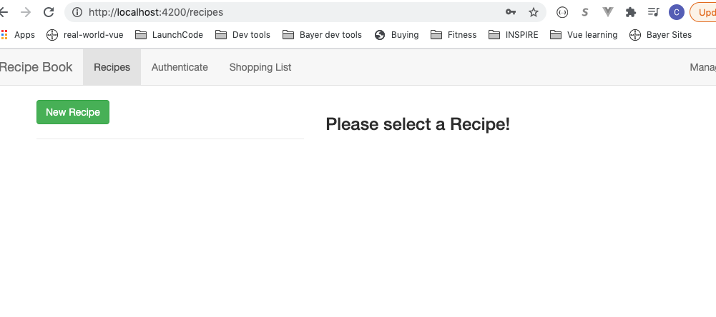
REFLECTING THE AUTH STATE IN THE UI
Notes:
We want to show relavant message based on user authentication state, and add logout once they are logged in. we want to check if we have a user with an auth token or not. Token expired then user subject will emit and event that updates the user.
48

Slide 49
ADDING THE TOKEN TO OUTGOING REQUESTS
Notes:
Need to attach the token to outgoing requests to let firebase know.
this.authService.user.pipe(take(1)).subscribe();
49

Slide 50
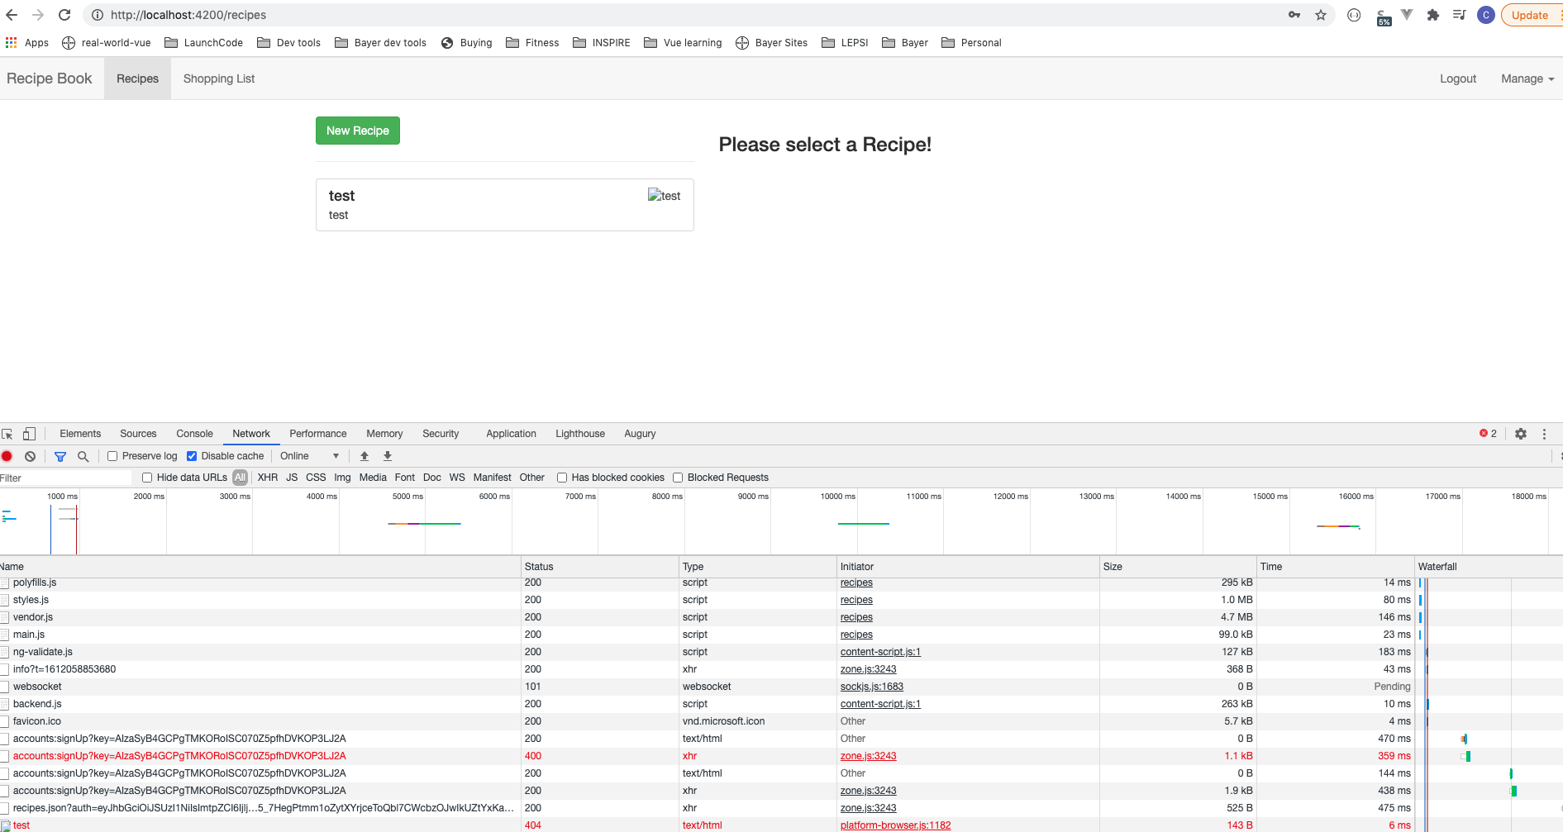
ADDING THE TOKEN TO OUTGOING REQUESTS
Notes:
Need to attach the token to outgoing requests to let firebase know.
this.authService.user.pipe(take(1)).subscribe();
50

Slide 51
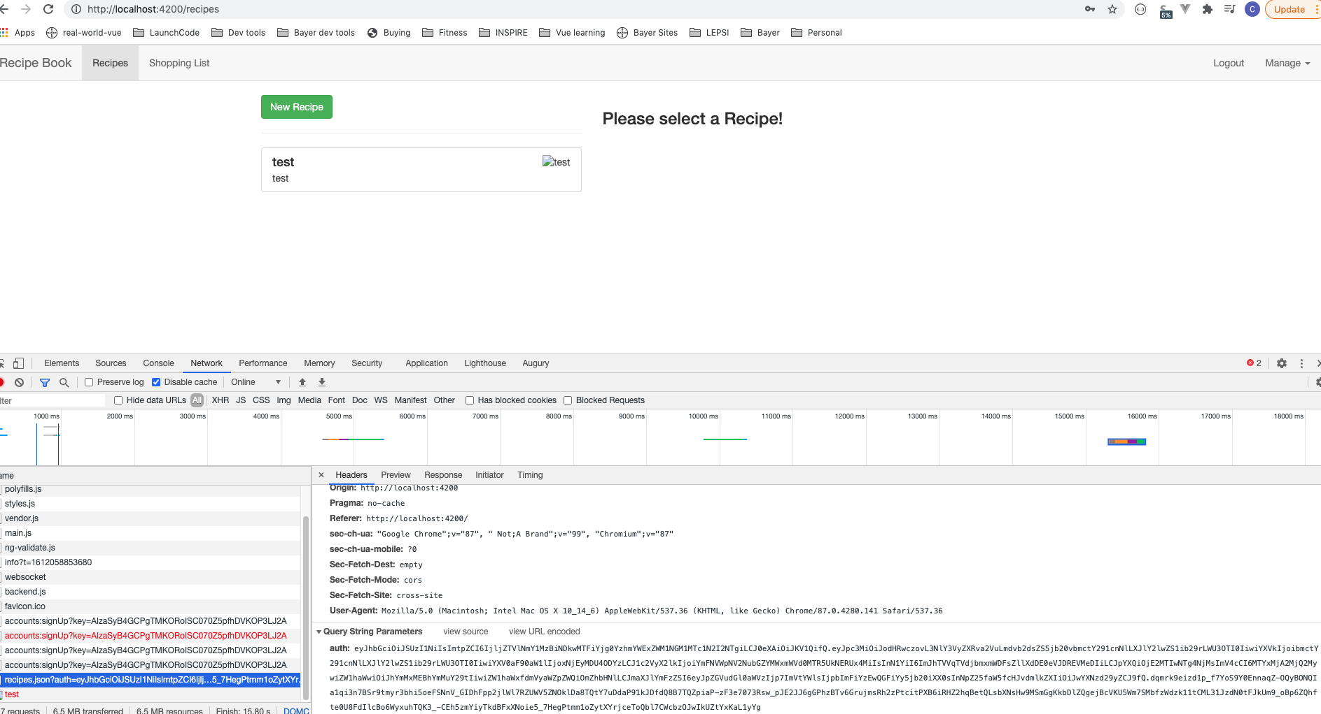
ADDING THE TOKEN TO OUTGOING REQUESTS
Notes:
Need to attach the token to outgoing requests to let firebase know.
this.authService.user.pipe(take(1)).subscribe();
51

Slide 52
ADDING THE TOKEN WITH AN INTERCEPTOR
Notes:
Need to attach the token to outgoing requests to let firebase know.
this.authService.user.pipe(take(1)).subscribe();
52

Slide 53
ADDING THE TOKEN WITH AN INTERCEPTOR
Notes:
Need to attach the token to outgoing requests to let firebase know.
this.authService.user.pipe(take(1)).subscribe();
53

Slide 54
ADDING THE TOKEN WITH AN INTERCEPTOR
Notes:
Need to attach the token to outgoing requests to let firebase know.
this.authService.user.pipe(take(1)).subscribe();
54

Slide 55
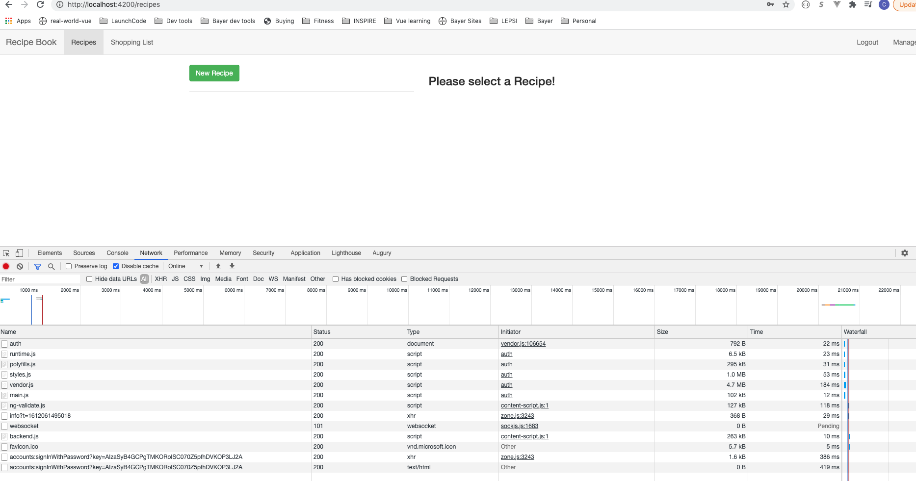
ADDING THE TOKEN WITH AN INTERCEPTOR
Notes:
Need to attach the token to outgoing requests to let firebase know.
this.authService.user.pipe(take(1)).subscribe();
55

Slide 56
ADDING LOGOUT
Notes:
Intercepter works for saving recipe as well.
56

Slide 57
ADDING LOGOUT
Notes:
Intercepter works for saving recipe as well.
57

Slide 58
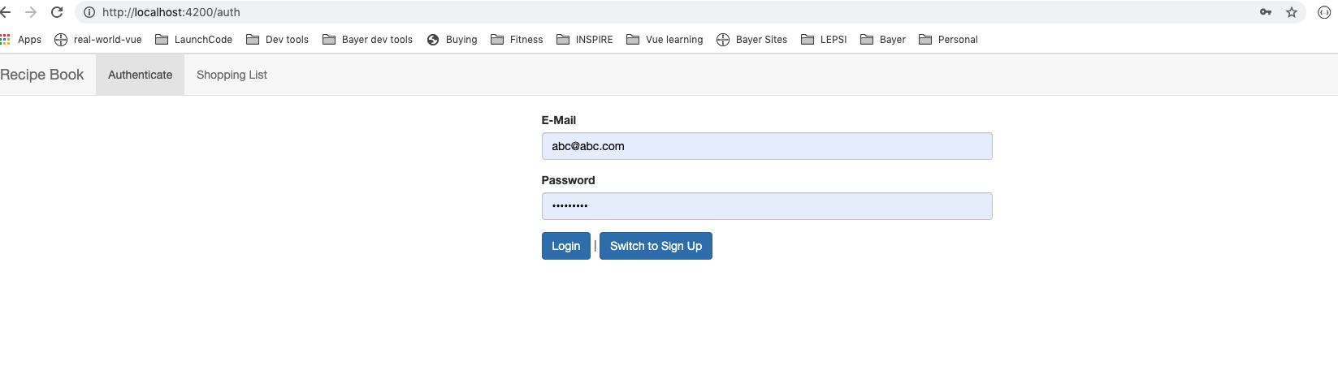
ADDING LOGOUT
Notes:
Intercepter works for saving recipe as well.
58

Slide 59
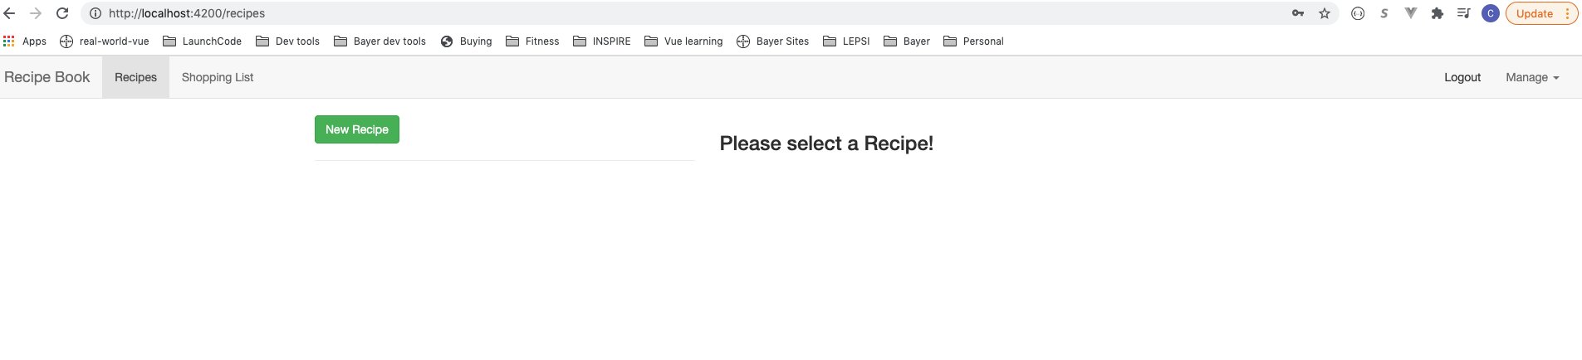
ADDING LOGOUT
Notes:
Intercepter works for saving recipe as well.
59

Slide 60
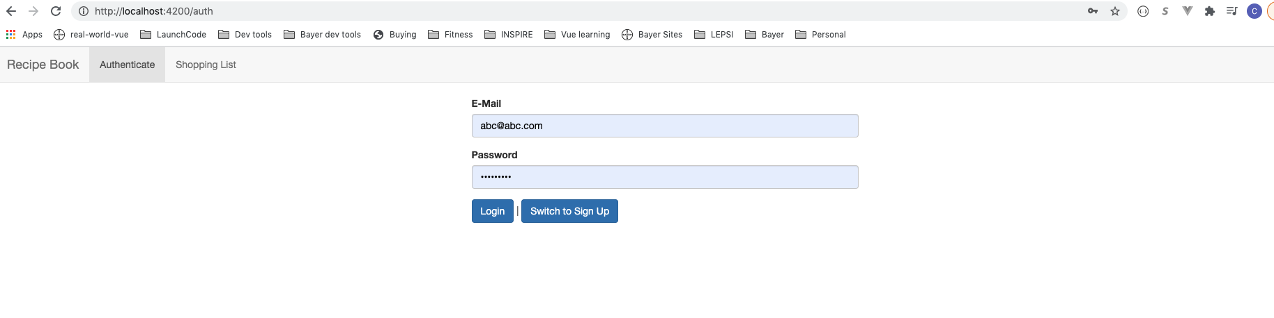
ADDING LOGOUT
Notes:
Intercepter works for saving recipe as well.
60

Slide 61
ADDING AUTO LOGIN
Notes:
In memory in user model. Cookies or local storage. Store simple key value pairs. We will use localStorage to store the tokens.
61

Slide 62
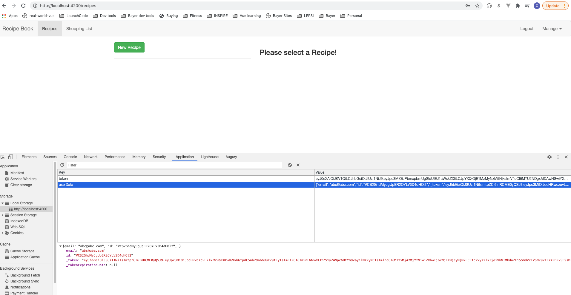
ADDING AUTO LOGIN
Notes:
In memory in user model. Cookies or local storage. Store simple key value pairs. We will use localStorage to store the tokens.
62

Slide 63
ADDING AUTO LOGIN
Notes:
In memory in user model. Cookies or local storage. Store simple key value pairs. We will use localStorage to store the tokens.
63

Slide 64
ADDING AUTO LOGIN
Notes:
In memory in user model. Cookies or local storage. Store simple key value pairs. We will use localStorage to store the tokens.
64

Slide 65
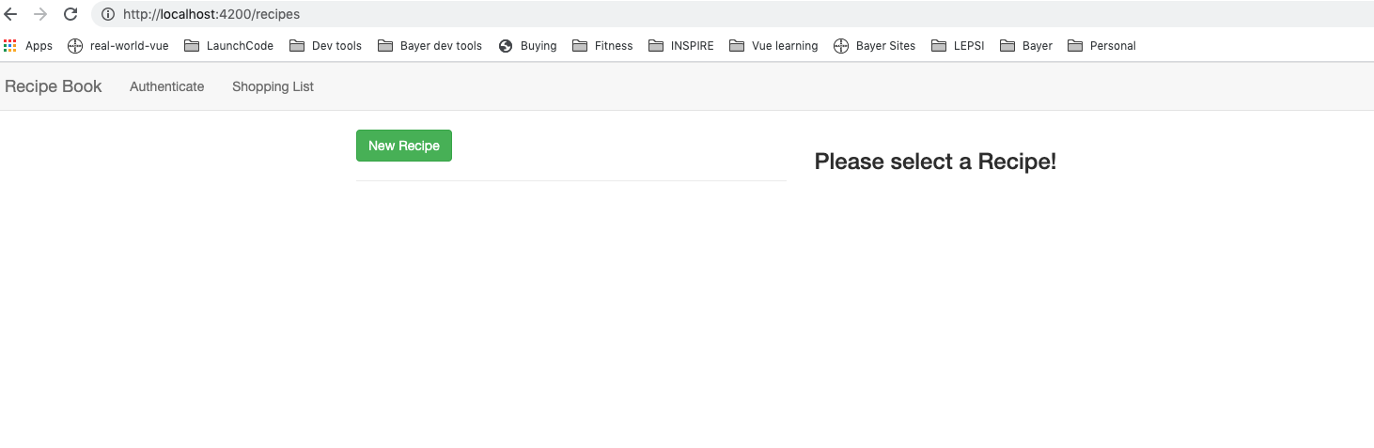
ADDING AUTO LOGIN
Notes:
In memory in user model. Cookies or local storage. Store simple key value pairs. We will use localStorage to store the tokens.
65

Slide 66
ADDING AUTO LOGOUT
Notes:
Token expires in an hour so snapshot should be cleared in an hour. Emit a new user – set auto logout and in auto login.
66

Slide 67
ADDING AUTH GUARD
Notes:
Preventing routes from being accessed. Recipes cannot be accessed directly.
67

Slide 68
ADDING AUTH GUARD
Notes:
Preventing routes from being accessed. Recipes cannot be accessed directly.
68

Slide 69
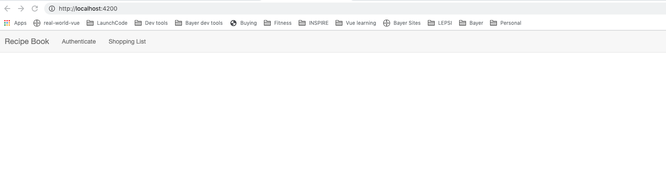
ADDING AUTH GUARD
Notes:
Recipes takes u to blank page. Lets login and retry. Now recipes can be accessed. Can change to reroute to auth.
69

Slide 70
ADDING AUTH GUARD
Notes:
Recipes takes u to blank page. Lets login and retry. Now recipes can be accessed. Can change to reroute to auth.
Confident adding Authn
70

Slide 71
Dynamic Components
Components created runtime conditionally.
For example, on Error.
Loaded via code.
Learn to create and load and communicate with it and get rid of it.
Notes:
71

Slide 72
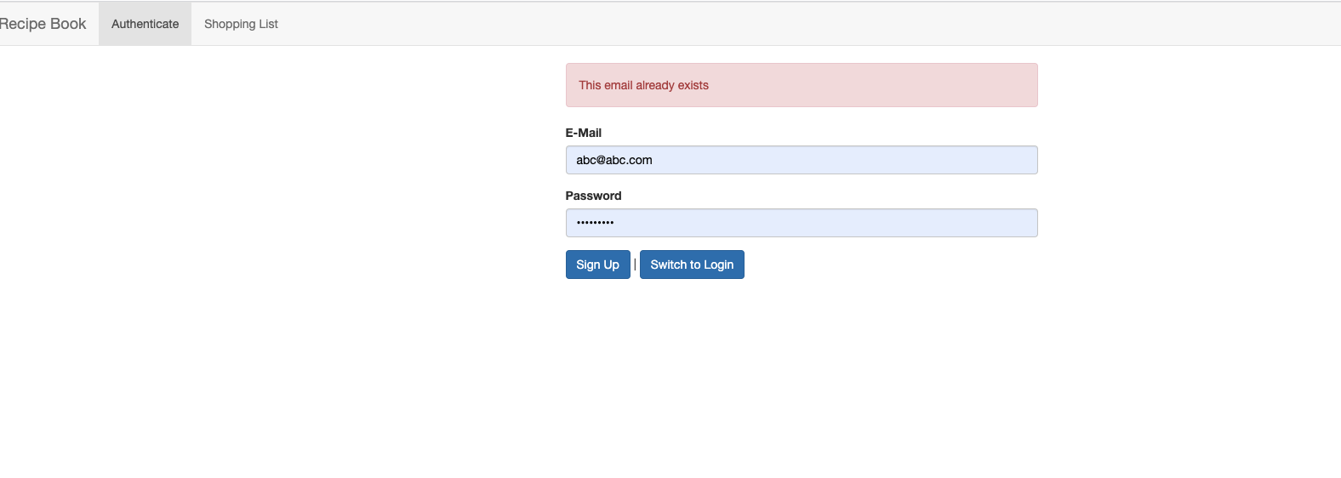
ADDING AN ALERT MODAL COMPONENT
Instead of having error message on screen, develop a alert modal for error
Notes:
72

Slide 73
ADDING AN ALERT MODAL COMPONENT
Notes:
73

Slide 74
ADDING AN ALERT MODAL COMPONENT
Notes:
74

Slide 75
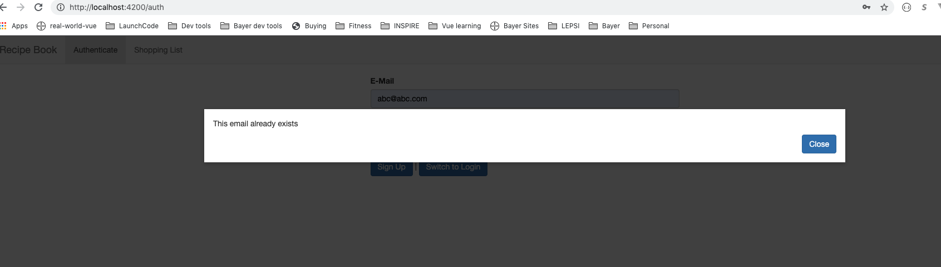
ADDING AN ALERT MODAL COMPONENT
Notes:
75

Slide 76
ADDING AN ALERT MODAL COMPONENT
Notes:
76

Slide 77
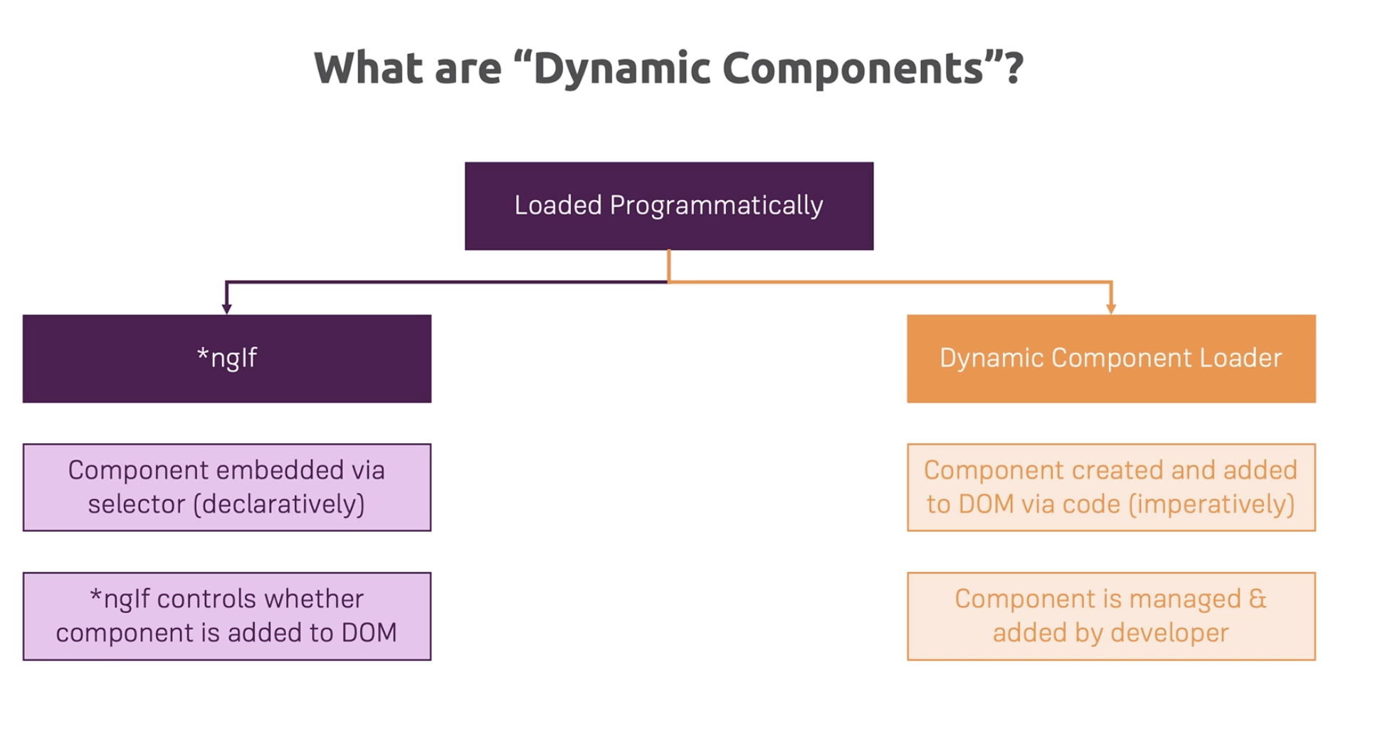
UNDERSTANDING THE DIFFERENT APPROACHES
Notes:
Dynamic Component Loader. Component created in code, need to manage component on your own.
77

Slide 78
UNDERSTANDING THE DIFFERENT APPROACHES
Notes:
Dynamic Component Loader. Component created in code, need to manage component on your own.
78

Slide 79
UNDERSTANDING THE DIFFERENT APPROACHES
Notes:
Dynamic Component Loader. Component created in code, need to manage component on your own.
79

Slide 80
UNDERSTANDING THE DIFFERENT APPROACHES
Notes:
Dynamic Component Loader. Component created in code, need to manage component on your own.
80

Slide 81
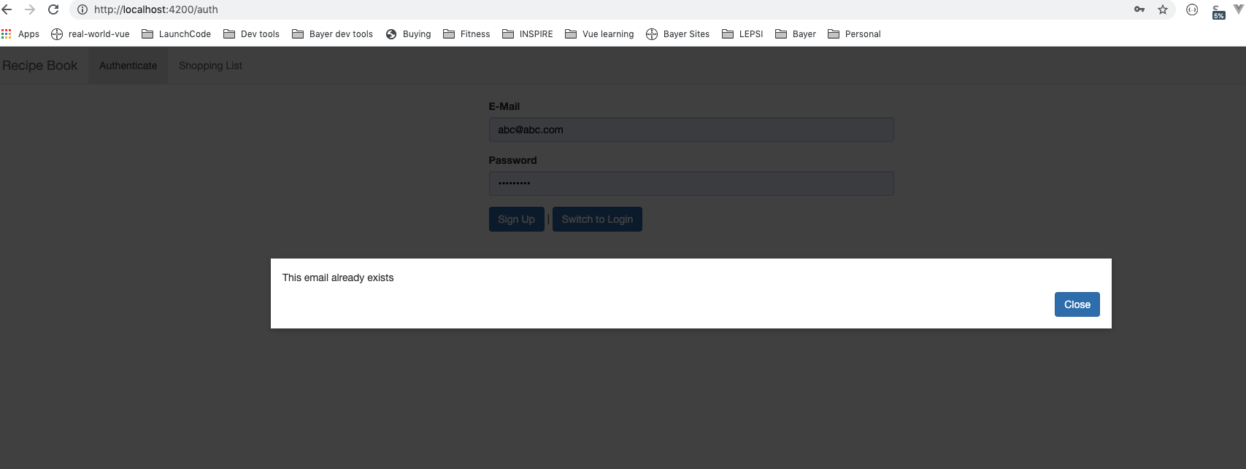
UNDERSTANDING THE DIFFERENT APPROACHES
Notes:
Dynamic Component Loader. Component created in code, need to manage component on your own.
81

Slide 82
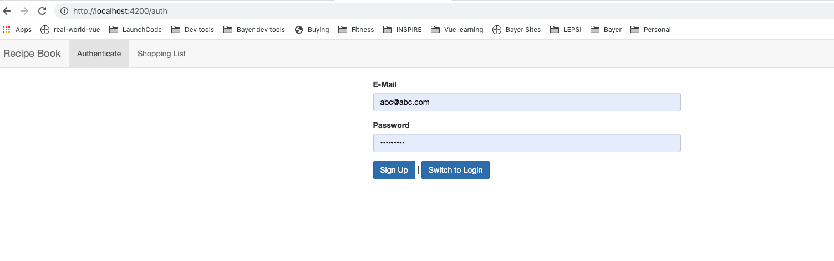
UNDERSTANDING THE DIFFERENT APPROACHES
Notes:
Dynamic Component Loader. Component created in code, need to manage component on your own.
82

Slide 83
PROGRAMMATIC CREATION
Notes:
Create the alert component from inside code.
const alertCmp = new AlertComponent(); doesn’t work, but u have to use Component Factory. ComponentFactoryResolver
Need ViewContainer ref. Pointer to ref in DOM.
<ng-template></ng-template>
83

Slide 84
PROGRAMMATIC CREATION
Notes:
Create the alert component from inside code.
const alertCmp = new AlertComponent(); doesn’t work, but u have to use Component Factory. ComponentFactoryResolver
Need ViewContainer ref. Pointer to ref in DOM.
<ng-template></ng-template>
84

Slide 85
PROGRAMMATIC CREATION
Notes:
Create the alert component from inside code.
const alertCmp = new AlertComponent(); doesn’t work, but u have to use Component Factory. ComponentFactoryResolver
Need ViewContainer ref. Pointer to ref in DOM.
<ng-template></ng-template>
85

Slide 86
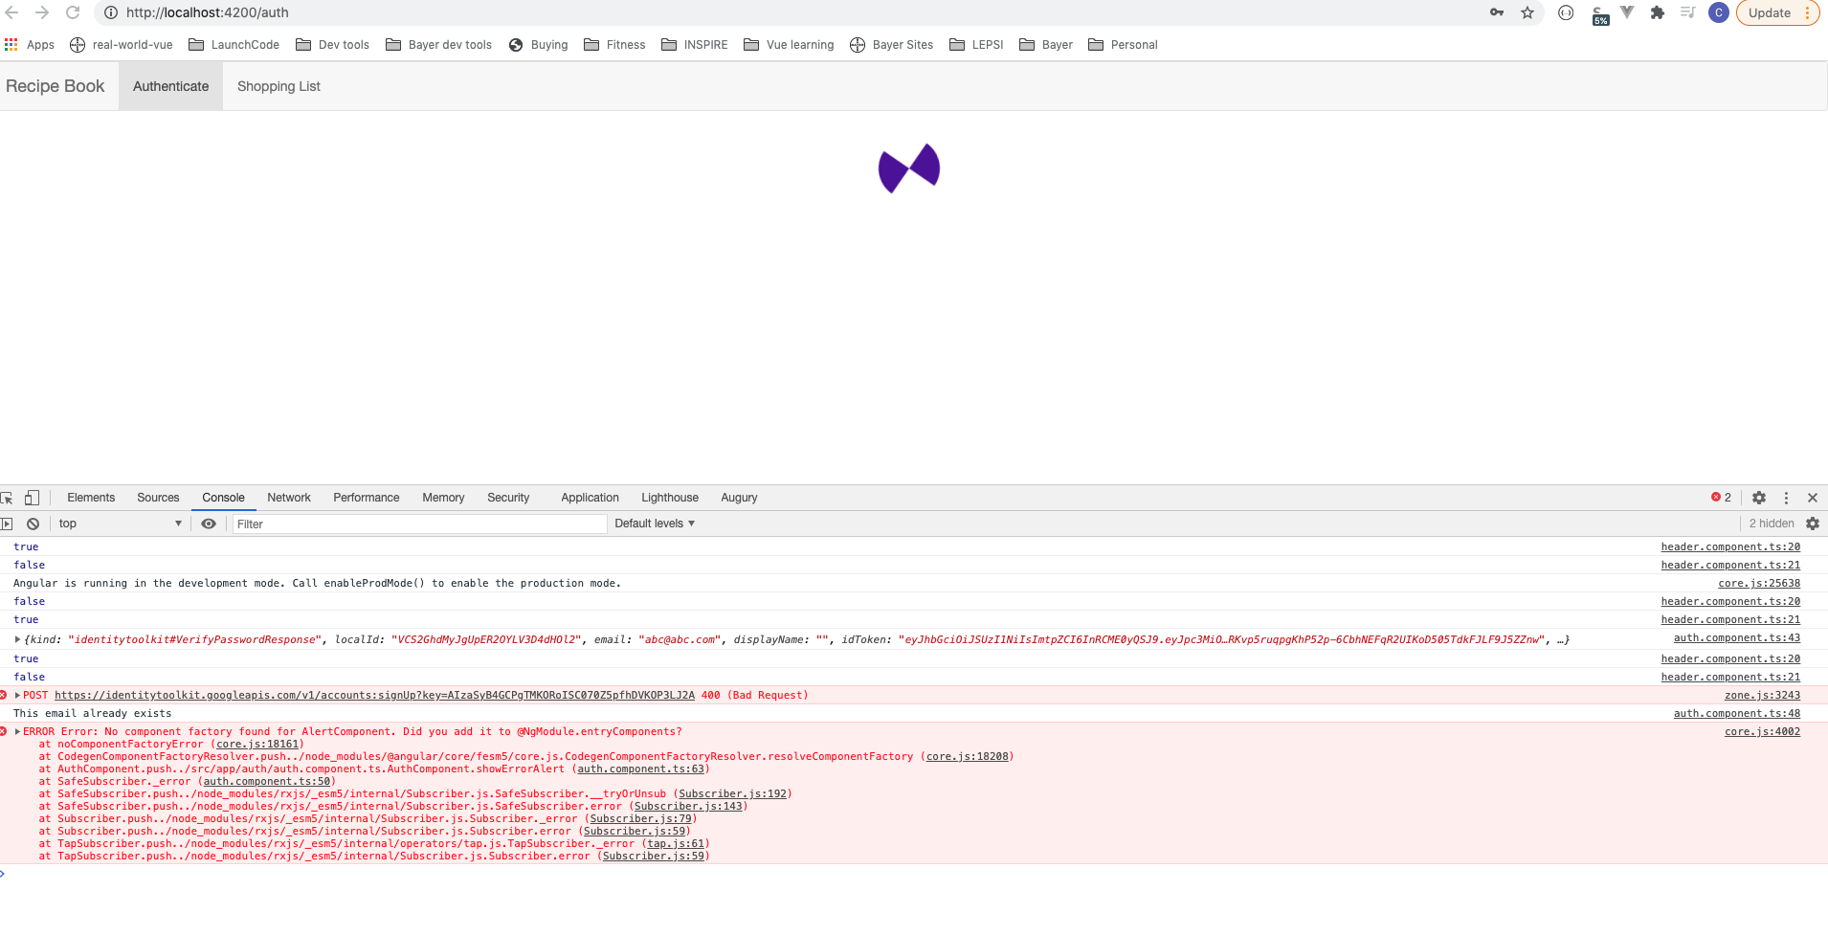
PROGRAMMATIC CREATION
Notes:
Works in Angular 9 or higher which makes this work.
86

Slide 87
PROGRAMMATIC CREATION
Notes:
Works in Angular 9 or higher which makes this work. Did not find Component Factory. Angular works behind the scene. Need to be added to Declarations Array.
Angular needs to understand what components are being used.
Angular looks based on selector, also in routes.
Manually created components don’t work automatically.
entryComponents that get created without using selector or router. Not needed in Angular 9 or higher.
87

Slide 88
DATA BINDING AND EVENT BINDING
Notes:
Can create dynamic components inside code.
ngIf is the simpler way to create dynamics conditionally. Does not clutter DOM.
88

Slide 89
Questions?

Slide 90
Studio
Course Project – Unit Testing

